Slide 1




Noida Institute of Engineering and Technology, Greater Noida
Unit V PHP
Unit: 5
Web Technology (ACSE0505)
Vaishali Mishra
Assistant Professor
CSE
Department
Course Details (Ex: B Tech 4th Sem)

Slide 2
Content
Evaluation Scheme
Syllabus
Branch wise syllabus
Course Objective
Course Outcome
Program Outcome
CO-PO Mapping
PSO
CO- PSO Mapping
PEO
Result analysis
Paper template
Prerequisites
Introduction to subject
Unit objective

Slide 3
Course Objective
Guidelines
Font Type {Calbri(body)/Arial/Times New Roman}
Topic Heading (Font Size: 24)
Primary Heading (Font Size: 22, Bold)
Sub Heading (Font Size: 20-22, Bold)
Content (Font Size: 18-22(Depending upon Content on Slide))
Content is preferred in bulleted, Diagrammatic, Animated form.
Content Should be justify Aligned.

Slide 4
Faculty Profile

Slide 5
Contents
Topic objective
Introduction to PHP,
Basic Syntax, Variables & Constants
Data Type, Operator & Expressions
Control flow and Decision making statements
Functions, Strings, Arrays
Understanding file & directory
Opening and closing, a file, Coping, renaming and deleting a file
Working with directories, Creating and deleting folder
File Uploading & Downloading
Introduction to Session Control
Session Functionality
What is a Cookie

Slide 6
Contents
Setting Cookies with PHP
Using Cookies with Sessions
Deleting Cookies
Registering Session variables
Destroying the variables and Session.
Video Links
Daily Quiz
Weekly Assignment
MCQs
Expected Questions in University Exams
Summary
References

Slide 7
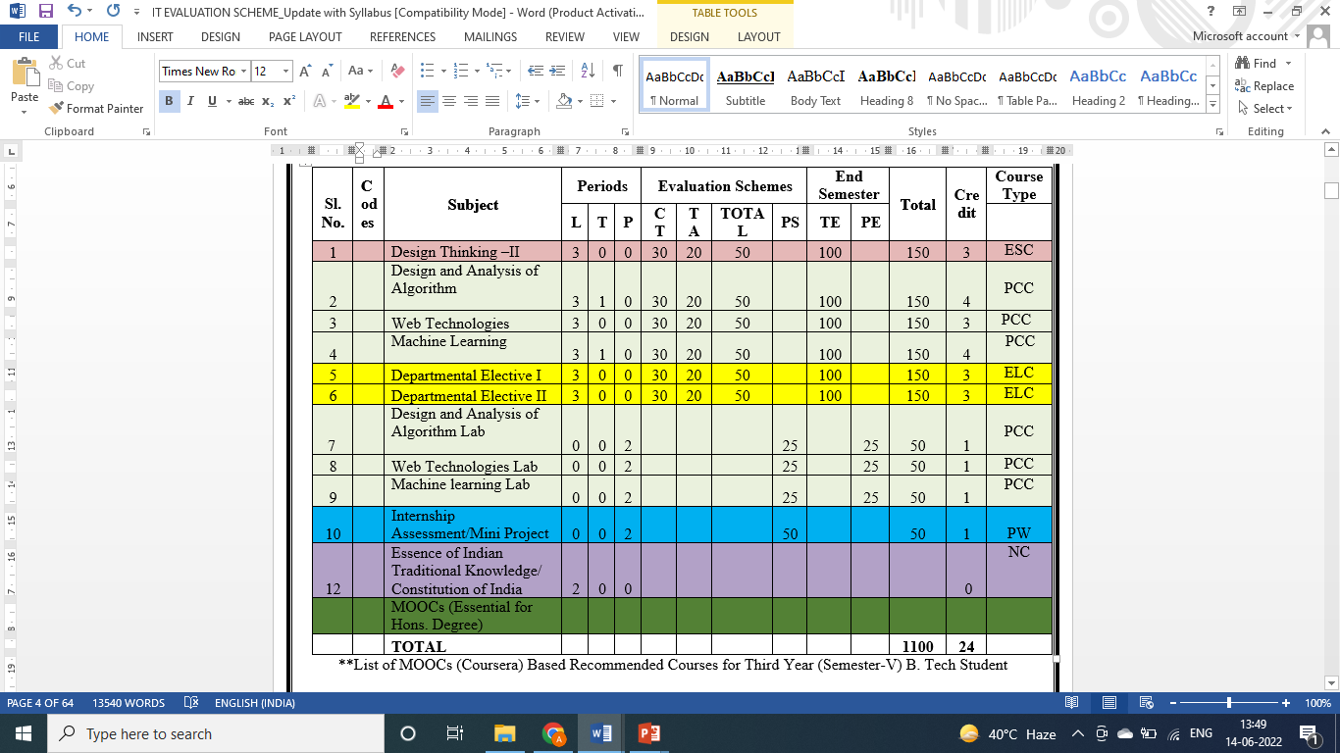
Evaluation Scheme

Slide 8
Syllabus
Unit | Topic
I | Introduction: Introduction to Web Technology, History of Web and Internet, Connecting to Internet, Introduction to Internet services and tools, Client-Server Computing, Protocols Governing Web, Basic principles involved in developing a web site, Planning process, Types of Websites, Web Standards and W3C recommendations, Web Hosting basics, introduction to web testing, functional testing, usability and visual testing, Performance and load testing.
II | HTML: What is HTML, DOM- Introduction to Document Object Model, Basic structure of an HTML document, Mark up Tags, Heading-Paragraphs , Line Breaks, Understand the structure of HTML tables. Lists, Working with Hyperlinks, Image Handling, Understanding Frames and their needs, HTML forms for User inputs. New form Elements- date, number, range, email, search and data list, Understanding audio, video and article tags. XML: Introduction, Tree, Syntax, Elements, Attributes, Namespaces, Display, HTTP request, Parser, DOM, XPath, XSLT, XQuerry, XLink, Validator, DTD, Schema, Server

Slide 9
Syllabus
III | Concept of CSS 3: Creating Style Sheet, CSS Properties , CSS Styling(Background, Text Format, Controlling Fonts) , Working with block elements and objects , Working with Lists and Tables , CSS Id and Class, Box Model(Introduction, Border properties, Padding Properties, Margin properties) CSS Advanced(Grouping, Dimension, Display, Positioning, Floating, Align, Pseudo class, Navigation Bar, Image Sprites, Attribute sector) , CSS Color, Creating page Layout and Site. Bootstrap: Introduction, Bootstrap grid system, Bootstrap Components.
IV | JavaScript Essentials: Introduction to Java Script , Javascript Types , Var, Let and Const Keywords, Operators in JS , Conditions Statements , Java Script Loops, JS Popup Boxes , JS Events , JS Arrays, Working with Arrays, JS Objects ,JS Functions , Using Java Script in Real time , Validation of Forms, Arrow functions and default arguments, Template Strings, Strings methods, Callback functions, Object de-structuring, Spread and Rest Operator, Typescript fundamentals, Typescript OOPs- Classes, Interfaces, Constructor etc. Decorator and Spread Operator, Difference == & ===, Asynchronous Programming in ES6, Promise Constructor, Promise with Chain, Promise Race.

Slide 10
Syllabus
V | Introduction to PHP, Basic Syntax, Variables & Constants, Data Type, Operator & Expressions, Control flow and Decision making statements, Functions, Strings, Arrays Working with files and directories: Understanding file& directory, Opening and closing, a file, Coping, renaming and deleting a file, working with directories, Creating and deleting folder, File Uploading & Downloading. Session & Cookies: Introduction to Session Control, Session Functionality What is a Cookie, Setting Cookies with PHP. Using Cookies with Sessions, Deleting Cookies, Registering Session variables, Destroying the variables and Session.

Slide 11
Branch wise Applications
Resource Sharing
Server-Client model
Communication Medium
Access to remote information
Person-to-person communication
Electronic commerce
Cloud-based Applications
AI and Expert System
Neural Networks and parallel programming
Decision support and office automation systems etc.

Slide 12
Course Objective
This course covers different aspect of web technology such as HTML, CSS, and issues of web technology, client and server side issue. The general objectives of this course are to provide fundamental concepts of Internet; Web Technology and Web Programming. Students will be able to build a proper responsive website.

Slide 13
Course Outcome
At the end of the course, the student will be able
Course Outcomes (CO) |  | Bloom’s Knowledge Level (KL)
 | Recalling the basic facts and explaining the basic ideas of Web technology and web hosting. | K1, K2
 | Applying and creating various HTML5 semantic elements and application with working on HTML forms for user input. | K3, K6
 | Understanding and applying the concepts of Creating Style Sheet (CSS)3 and bootstrap. | K2, K3
 | Analysing and implementing concept of Java Script and its applications. | K4, K6
 | Creating and evaluating dynamic web pages using the concept of PHP | K5, K6

Slide 14
Program Outcome
1. Engineering knowledge
2. Problem analysis
3. Design/development of solutions
4. Conduct investigations of complex problems
5. Modern tool usage
6. The engineer and society
7. Environment and sustainability
8. Ethics
9. Individual and team work
10. Communication
11. Project management and finance
12. Life-long learning

Slide 15
CO-PO Mapping
The highlighted text shows the mapping of course outcome with PO mapping of this unit
Subject Code is Not Assigned | PO1 | PO2 | PO3 | PO4 | PO5 | PO6 | PO7 | PO8 | PO9 | PO10 | PO11 | PO12
 | 3 | 2 | 2 | 1 | 1 | 1 | 1 | 1 | 3 | 3 | 2 | 3
 | 3 | 2 | 3 | 1 | 3 | 2 | 2 | 1 | 3 | 3 | 3 | 3
 | 3 | 2 | 3 | 2 | 3 | 2 | 2 | 2 | 3 | 3 | 2 | 3
 | 3 | 3 | 3 | 2 | 3 | 2 | 2 | 2 | 3 | 3 | 2 | 3
 | 3 | 3 | 3 | 2 | 3 | 2 | 2 | 2 | 3 | 3 | 2 | 3
Average | 3 | 2.4 | 2.8 | 1.6 | 2.6 | 1.8 | 1.8 | 1.6 | 3 | 3 | 2.2 | 3

Slide 16
Program Specific Outcomes
PSO1: Work as a software developer, database administrator, tester or networking engineer for providing solutions to the real world and industrial problems.
PSO2:Apply core subjects of information technology related to data structure and algorithm, software engineering, web technology, operating system, database and networking to solve complex IT problems.
PSO3: Practice multi-disciplinary and modern computing techniques by lifelong learning to establish innovative career.
PSO4: Work in a team or individual to manage projects with ethical concern to be a successful employee or employer in IT industry.

Slide 17
CO-PSO Mapping
The highlighted text shows the mapping of course outcome with PSO mapping of this unit
Course Outcomes | Program Specific Outcomes
 | PSO1 | PSO2 | PSO3 | PSO4
 | 3 | 3 | 2 | 3
 | 3 | 3 | 3 | 2
 | 3 | 3 | 2 | 2
 | 3 | 2 | 3 | 2
 | 3 | 2 | 2 | 2
AVG | 3 | 2.6 | 2.4 | 2.2

Slide 18
Program Educational Objectives
PEO1: able to apply sound knowledge in the field of information technology to fulfill the needs of IT industry.
PEO2: able to design innovative and interdisciplinary systems through latest digital technologies.
PEO3: able to inculcate professional and social ethics, team work and leadership for serving the society.
PEO4: able to inculcate lifelong learning in the field of computing for successful career in organizations and R&D sectors.

Slide 19
Result Analysis
Result of 2022-23: 98.7%
Average Marks: 54.33

Slide 20
End Semester Question Paper Template
B TECH
(SEM-V) THEORY EXAMINATION 20__-20__
Time: 3 Hours Total Marks: 100
Note: 1. Attempt all Sections. If require any missing data; then choose suitably.
SECTION A
Attempt all questions in brief. 1 x 10 = 10
Q.No. | Question | Marks | CO
1 |  | 1
2 |  | 1
. |  | .
10 |  | 1

Slide 21
2. Attempt of the following: 5 x 2 = 20
SECTION B
3. Attempt any five part of the following: 5 x 6 = 30
Q.No. | Question | Marks | CO
1 |  | 2
2 |  | 2
. |  | .
5 |  | 2
Q.No. | Question | Marks | CO
1 |  | 6
. |  | 6
7 |  | 6

Slide 22
End Semester Question Paper Template
2. Attempt of the following: 5 x 2 = 20
SECTION B
3. Attempt any five part of the following: 5 x 6 = 30
Q.No. | Question | Marks | CO
1 |  | 2
2 |  | 2
. |  | .
5 |  | 2
Q.No. | Question | Marks | CO
1 |  | 6
. |  | 6
7 |  | 6

Slide 23
Prerequisite
The student should have knowledge of
Web
Browser and application
Hardware and data sharing
The basic knowledge of C

Slide 24
Brief Introduction to Subject
Web Technology refers to the various tools and techniques that are utilized in the process of communication between different types of devices over the internet.
A web browser is used to access web pages. Web browsers can be defined as programs that display text, data, pictures, animation, and video on the Internet.
Hyperlinked resources on the World Wide Web can be accessed using software interfaces provided by Web browsers.
https://www.youtube.com/results?search_query=Web+Technonogies

Slide 25
Topic Mapping with Course Outcome
Topics | Course outcome
Introduction to PHP, Basic Syntax, Variables & Constants, Data Type, Operator & Expressions, Control flow and Decision making statements, Functions, Strings, Arrays Working with files and directories: Understanding file& directory, Opening and closing, a file, Coping, renaming and deleting a file, working with directories, Creating and deleting folder, File Uploading & Downloading. Session & Cookies: Introduction to Session Control, Session Functionality What is a Cookie, Setting Cookies with PHP. Using Cookies with Sessions, Deleting Cookies, Registering Session variables, Destroying the variables and Session. | CO5 CO5 CO5

Slide 26
Unit Objective
Read, understand and implement the PHP language in real world projects.

Slide 27
Topic and Topic objective
Introduction to PHP, syntax, variables, constants :
To discuss about basics of PHP with its syntax, variables and constants.

Slide 28
Introduction to PHP (CO5)
The term PHP is an acronym for PHP: Hypertext Preprocessor. PHP is a server-side scripting language designed specifically for web development.
PHP is a server side scripting language that is embedded in HTML. It is used to manage dynamic content, databases, session tracking, even build entire e-commerce sites.
It is integrated with a number of popular databases, including MySQL, PostgreSQL,
Oracle, Sybase, Informix, and Microsoft SQL Server.
PHP supports a large number of major protocols such as POP3, IMAP, and LDAP. PHP is forgiving: PHP language tries to be as forgiving as possible.
PHP Syntax is C-Like.

Slide 29
Introduction to PHP (CO5)
It supports main protocols like HTTP Basic, HTTP Digest, IMAP, FTP, and others.
Common Uses of PHP:
PHP performs system functions, i.e. from files on a system it can create, open, read, write, and close them. The other uses of PHP are:
PHP can handle forms, i.e. gather data from files, save data to a file, thru email you can send data, return data to the user.
You add, delete, modify elements within your database thru PHP.
Access cookies variables and set cookies.
Using PHP, you can restrict users to access some pages of your website.
It can encrypt data.

Slide 30
Basics syntax (CO5)
A PHP script can be placed anywhere in the document.
A PHP script starts with <?php and ends with ?>:
<?php
// PHP code goes here
?>
The default file extension for PHP files is ".php". A PHP file normally contains HTML tags, and some PHP scripting code.
Below, we have an example of a simple PHP file, with a PHP script that uses a built-in PHP function "echo" to output the text "Hello World!" on a web page:
Example-<html>
<head><title>Hello World</title>
<body><?php echo "Hello, World!";?></body></html

Slide 31
Basics syntax (CO5)
Web Server - PHP will work with virtually all Web Server software, including Microsoft's Internet Information Server (IIS) but then most often used is freely available Apache Server.
Download Apache for free here: http://httpd.apache.org/download.cgi
Database - PHP will work with virtually all database software, including Oracle and Sybase but most commonly used is freely available MySQL database. Download MySQL for free here:
http://www.mysql.com/downloads/index.html
PHP Parser - In order to process PHP script instructions, a parser must be installed to generate HTML output that can be sent to the Web Browser. This tutorial will guide you how to install PHP parser on your computer.

Slide 32
Variables & Constants (CO5)
In PHP, variables and constants are used to store and represent data in a program. However, they have some key differences:
Variables:
Variables are used to store data that may change during the execution of a script.
The value of a variable can be reassigned multiple times during the program's execution.
PHP variables start with a dollar sign ($) followed by the variable name (e.g., $variableName).
Variables are case-sensitive, so $variable and $Variable are considered different variables.
You don't need to declare variables explicitly before using them; they are created dynamically when assigned a value.

Slide 33
Variables & Constants (CO5)
$name = "John"; // String variable
$age = 30; // Integer variable
$height = 1.75; // Float variable
$isStudent = true; // Boolean variable
Rules for declaring PHP variable:
A variable must start with a dollar ($) sign, followed by the variable name.
It can only contain alpha-numeric character and underscore (A-z, 0-9, _).
A variable name must start with a letter or underscore (_) character.
A PHP variable name cannot contain spaces.
One thing to be kept in mind that the variable name cannot start with a number or special symbols.
PHP variables are case-sensitive, so $name and $NAME both are treated as different variable.

Slide 34
Variables & Constants (CO5)
PHP Variable: Declaring string, integer, and float
Let's see the example to store string, integer, and float values in PHP variables.
<?php
$str="hello string";
$x=200;
$y=44.6;
echo "string is: $str <br/>";
echo "integer is: $x <br/>";
echo "float is: $y <br/>";
?>

Slide 35
Variables & Constants (CO5)
Output:
string is: hello string
integer is: 200
float is: 44.6

Slide 36
Variables & Constants (CO5)
PHP constants are name or identifier that can't be changed during the execution of the script except for magic constants, which are not really constants.
PHP constants can be defined by 2 ways:
Using define() function
Using const keyword
Constants are similar to the variable except once they defined, they can never be undefined or changed.

Slide 37
Variables & Constants (CO5)
They remain constant across the entire program. PHP constants follow the same PHP variable rules.
For example, it can be started with a letter or underscore only. Conventionally, PHP constants should be defined in uppercase letters.
1. PHP constant: define()
Use the define() function to create a constant.
It defines constant at run time. Let's see the syntax of define() function in PHP.
define(name, value, case-insensitive)
<?php
define("MESSAGE","Hello PHP");
echo MESSAGE;
?>
Output:
Hello PHP

Slide 38
Variables & Constants (CO5)
2. PHP constant: const keyword
PHP introduced a keyword const to create a constant. The const keyword defines constants at compile time. It is a language construct, not a function. The constant defined using const keyword are case-sensitive.
<?php
const MESSAGE="Hello const by PHP";
echo MESSAGE;
?>
Output:
Hello const by PHP

Slide 39
Daily Quiz
1) PHP stands for -
A)Hypertext Preprocessor
B)Pretext Hypertext Preprocessor
C)Personal Home Processor
D)None of the above
2) Who is known as the father of PHP?
A)Drek Kolkevi
B)List Barely
C)Rasmus Lerdrof
D)None of the above

Slide 40
Daily Quiz
3) Which of the following statements is true about variables and constants in PHP?
A) Variables are used for storing data that remains the same throughout the script execution.
B) Constants can be reassigned multiple times during the execution of a script.
C) Variables are case-insensitive, while constants are case-sensitive.
D) Constants are created dynamically when assigned a value, while variables need to be declared before use.
4)Variable name in PHP starts with -
A)! (Exclamation)
B)$ (Dollar)
C)& (Ampersand)
D)# (Hash)

Slide 41
Daily Quiz
5) Which of the following is the default file extension of PHP?
A).php
B).hphp
C).xml
D).html
6) Which of the following is not a variable scope in PHP?
A)Extern
B)Local
C)Static
D)Global

Slide 42
Topic
Overview of Data Type, Operator & Expressions in PHP
Topic Objective
To discuss about data type, operator and expression in PHP

Slide 43
Recap
In the last lecture we have discussed about
- Introduction of basic of PHP with its syntax variables and constant.

Slide 44
Data type (CO5)
PHP data types are used to hold different types of data or values. PHP supports 8 primitive data types that can be categorized further in 3 types:
Scalar Types (predefined)
Compound Types (user-defined)
Special Types
1 Scalar Types- It holds only single value. There are 4 scalar data types in PHP.
boolean
integer
float
string

Slide 45
2 Compound Types- It can hold multiple values. There are 2 compound data types in PHP.
array
object
3 Special Types- There are 2 special data types in PHP.
resource
NULL

Slide 46
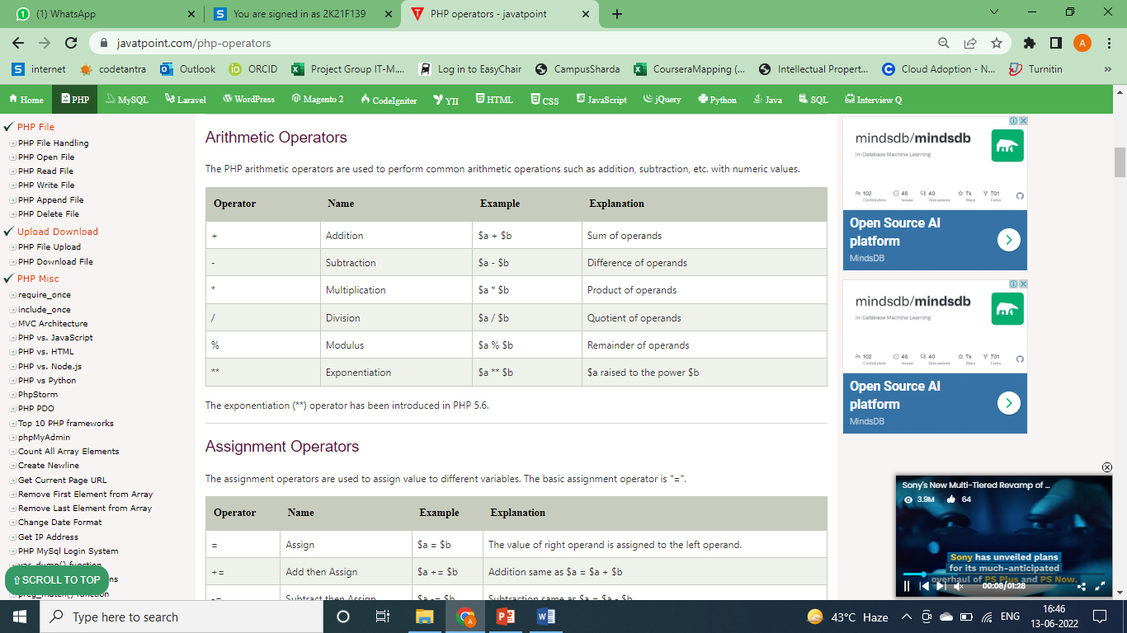
Operator (CO5)
PHP Operator is a symbol i.e used to perform operations on operands. In simple words, operators are used to perform operations on variables or values.

Slide 47
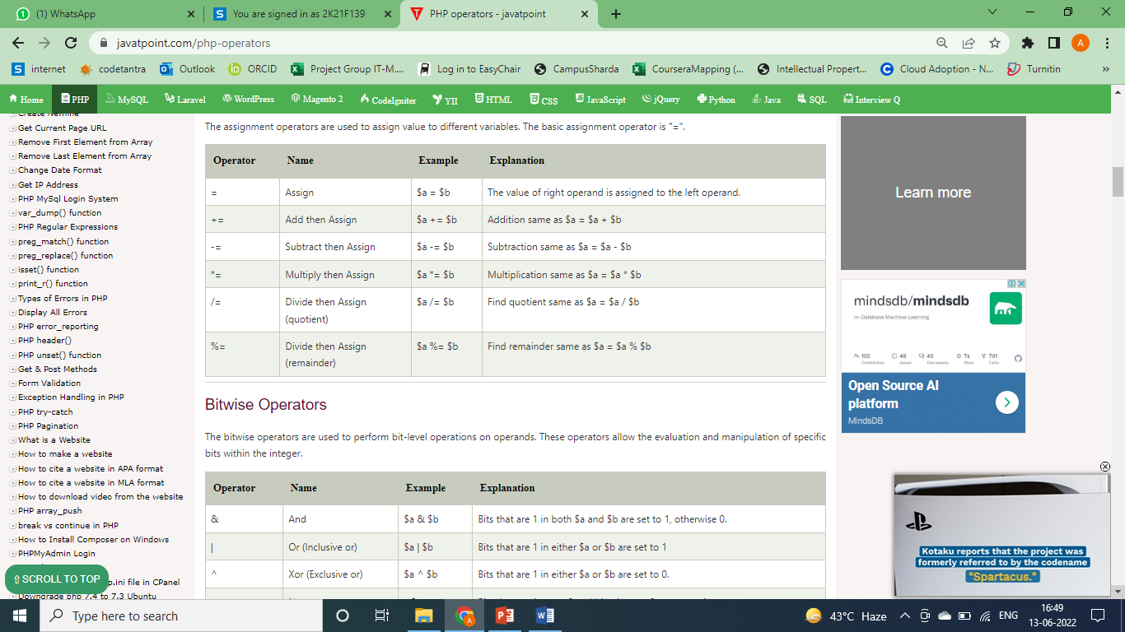
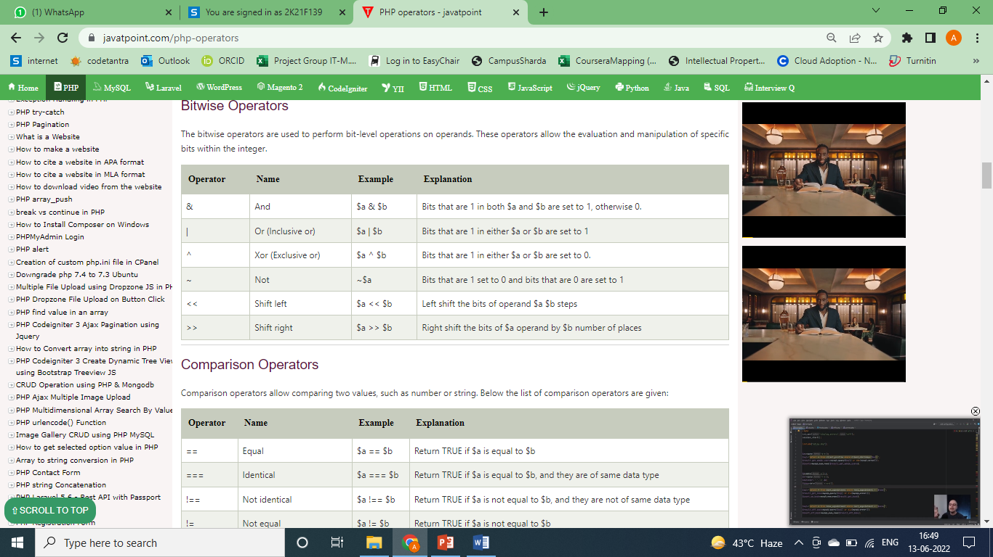
Operator (CO5)

Slide 48
Expression (CO5)
An expression is a bit of PHP that can be evaluated to produce a value. The simplest expressions are literal values and variables.
A literal value evaluates to itself, while a variable evaluates to the value stored in the variable.
More complex expressions can be formed using simple expressions and operators.

Slide 49
Control flow and Decision making statements (CO5)
1 PHP if- statement allows conditional execution of code. It is executed if condition is true. If statement is used to executes the block of code exist inside the if statement only if the specified condition is true.
Syntax
if(condition){
//code to be executed
}

Slide 50
Control flow and Decision making statements (CO5)
2 PHP if-else statement is executed whether condition is true or false. If-else statement is slightly different from if statement. It executes one block of code if the specified condition is true and another block of code if the condition is false.
Syntax
if(condition){
//code to be executed if true
}else{
//code to be executed if false
}

Slide 51
Control flow and Decision making statements (CO5)
3 The PHP if-else-if is a special statement used to combine multiple if-else statements. So, we can check multiple conditions using this statement.
Syntax
if (condition1){
//code to be executed if condition1 is true
} elseif (condition2){
//code to be executed if condition2 is true
} elseif (condition3){
//code to be executed if condition3 is true
....
} else{
//code to be executed if all given conditions are false
}

Slide 52
Control flow and Decision making statements (CO5)
4 PHP switch statement is used to execute one statement from multiple conditions. It works like PHP if-else-if statement.
Syntax
switch(expression){
case value1:
//code to be executed
break;
case value2:
//code to be executed
break;
......
default:
code to be executed if all cases are not matched;
}

Slide 53
Control flow and Decision making statements (CO5)
5 PHP for loop can be used to traverse set of code for the specified number of times. It should be used if the number of iterations is known otherwise use while loop. This means for loop is used when you already know how many times you want to execute a block of code. It allows users to put all the loop related statements in one place.
Syntax
for(initialization; condition; increment/decrement){
//code to be executed
}

Slide 54
Control flow and Decision making statements (CO5)
6 PHP while loop can be used to traverse set of code like for loop. The while loop executes a block of code repeatedly until the condition is FALSE. Once the condition gets FALSE, it exits from the body of loop. It should be used if the number of iterations is not known.
Syntax
while(condition){
//code to be executed
}

Slide 55
Control flow and Decision making statements (CO5)
7 PHP do-while loop can be used to traverse set of code like php while loop. The PHP do-while loop is guaranteed to run at least once. The PHP do-while loop is used to execute a set of code of the program several times. If you have to execute the loop at least once and the number of iterations is not even fixed, it is recommended to use the do-while loop.
Syntax
do{
//code to be executed
}while(condition);

Slide 56
Control flow and Decision making statements (CO5)
8 PHP break statement breaks the execution of the current for, while, do-while, switch, and for-each loop. If you use break inside inner loop, it breaks the execution of inner loop only. The break statement can be used in all types of loops such as while, do-while, for, foreach loop, and also with switch case.
Syntax
jump statement;
break;

Slide 57
Daily Quiz
1) Variable name in PHP starts with -
! (Exclamation)
$ (Dollar)
& (Ampersand)
# (Hash)
2) Default file extension of PHP?
A).php
B).hphp
C).xml
D).html

Slide 58
Daily Quiz
3) Which of the following is used to display the output in PHP?
A)echo
B)write
C)print
D)Both (a) and (c)
4) Which of the following is correct to add a comment in php?
A)& …… &
B)// ……
C)/* …… */
D)Both (b) and (c)

Slide 59
Topic
Overview of function, string & arrays in PHP
Topic objective
To discuss about function, string and arrays in PHP

Slide 60
Recap
In the last lecture we have discussed about
- Introduction of basic of PHP with Data Type, Operator & Expressions, Control flow and Decision making statements.

Slide 61
Functions (CO5)
PHP function is a piece of code that can be reused many times. It can take input as argument list and return value. There are thousands of built-in functions in PHP.
In PHP, we can define Conditional function, Function within Function and Recursive function also.
PHP User-defined Functions
We can declare and call user-defined functions easily. Let's see the syntax to declare user-defined functions.
Syntax
function functionname(){
//code to be executed
}

Slide 62
Functions (CO5)
1 PHP Parameterized functions are the functions with parameters. You can pass any number of parameters inside a function. These passed parameters act as variables inside your function. They are specified inside the parentheses, after the function name. The output depends upon the dynamic values passed as the parameters into the function.

Slide 63
Functions (CO5)
2 PHP call by value function allows you to call function by value and reference both. In case of PHP call by value, actual value is not modified if it is modified inside the function.
<?php
function adder($str2)
{
$str2 .= 'Call By Value';
}
$str = 'Hello ';
adder($str);
echo $str;
?>

Slide 64
Functions (CO5)
3 In case of PHP call by reference, actual value is modified if it is modified inside the function. In such case, you need to use & (ampersand) symbol with formal arguments. The & represents reference of the variable.
<?php
function adder(&$str2)
{
$str2 .= 'Call By Reference';
}
$str = 'This is ';
adder($str);
echo $str;
?>

Slide 65
Functions (CO5)
4 PHP Default Argument Values Function allows you to define C++ style default argument values. In such case, if you don't pass any value to the function, it will use default argument value.
<?php
function sayHello($name="Ram"){
echo "Hello $name<br/>";
}
sayHello("Sonoo");
sayHello();//passing no value
sayHello("Vimal");
?>

Slide 66
String (CO5)
PHP string is a sequence of characters i.e., used to store and manipulate text. PHP supports only 256-character set and so that it does not offer native Unicode support. There are 4 ways to specify a string literal in PHP.
1 Single Quoted- We can create a string in PHP by enclosing the text in a single-quote. It is the easiest way to specify string in PHP.
For specifying a literal single quote, escape it with a backslash (\) and to specify a literal backslash (\) use double backslash (\\).
All the other instances with backslash such as \r or \n, will be output same as they specified instead of having any special meaning.

Slide 67
String (CO5)
2 Doubled Quoted- In PHP, we can specify string through enclosing text within double quote also.
But escape sequences and variables will be interpreted using double quote PHP strings.
<?php
$str="Hello text within double quote";
echo $str;
?>
Output:
Hello text within double quote

Slide 68
String (CO5)
3 Heredoc syntax (<<<) is the third way to delimit strings. In Heredoc syntax, an identifier is provided after this heredoc <<< operator, and immediately a new line is started to write any text. To close the quotation, the string follows itself and then again that same identifier is provided. That closing identifier must begin from the new line without any whitespace or tab.
<?php
$str = <<<Demo
It is a valid example
Demo; //Valid code as whitespace or tab is not valid before closing identifier
echo $str;
?>
Output:
It is a valid example

Slide 69
String (CO5)
4 Newdoc is similar to the heredoc, but in newdoc parsing is not done.
It is also identified with three less than symbols <<< followed by an identifier.
But here identifier is enclosed in single-quote, e.g. <<<'EXP'. Newdoc follows the same rule as heredocs.
The difference between newdoc and heredoc is that - Newdoc is a single-quoted string whereas heredoc is a double-quoted string.

Slide 70
Array (CO5)
PHP array is an ordered map (contains value on the basis of key). It is used to hold multiple values of similar type in a single variable. We don't need to define multiple variables. By the help of single loop, we can traverse all the elements of an array. We can sort the elements of array. There are 3 types of array in PHP.
1 PHP indexed array is represented by number which starts from 0. We can store number, string and object in the PHP array.
All PHP array elements are assigned to an index number by default. There are two ways to define indexed array:

Slide 71
Array (CO5)
1st way:
$season=array("summer","winter","spring","autumn");
2nd way:
$season[0]="summer";
$season[1]="winter";
$season[2]="spring";
$season[3]="autumn";

Slide 72
Array (CO5)
2 PHP associative array allows you to associate name/label with each array elements in PHP using => symbol. Such way, you can easily remember the element because each element is represented by label than an incremented number. There are two ways to define associative array:
1st way:
$salary=array("Sonoo"=>"550000","Vimal"=>"250000","Ratan"=>"200000");
2nd way:
$salary["Sonoo"]="550000";
$salary["Vimal"]="250000";
$salary["Ratan"]="200000";

Slide 73
Array (CO5)
3 PHP multidimensional array is also known as array of arrays. It allows you to store tabular data in an array. PHP multidimensional array can be represented in the form of matrix which is represented by row * column.
$emp = array
(
array(1,"sonoo",400000),
array(2,"john",500000),
array(3,"rahul",300000)
);

Slide 74
Daily Quiz
1) How to define a function in PHP?
a) functionName(parameters) {function body}
b) function {function body}
c) function functionName(parameters) {function body}
d) data type functionName(parameters) {function body}
2) Which is the right way of declaring a variable in PHP?
a) $3hello
b) $_hello
c) $this
d) $5_Hello

Slide 75
Topic
Overview of files and directories
Topic Objective
To discuss about Understanding file& directory, Opening and closing, a file, Coping, renaming and deleting a file, working with directories, Creating and deleting folder, File Uploading & Downloading in PHP

Slide 76
Understanding file & directory, working with directories (CO5)
Now that we have spent some time looking at how to work with files in PHP it is now time to look at how to work with file system directories.
PHP provides a number of functions that can be used to perform tasks such as identifying and changing the current directory, creating new directories, deleting existing directories and listing the contents of a directory.
1 Creating Directories in PHP- A new directory can be created in PHP using the mkdir() function. This function takes a path to the directory to be created.
To create a directory in the same directory as your PHP script simply provide the directory name. To create a new directory in a different directory specify the full path when calling mkdir().
A second, optional argument allows the specification of permissions on the directory (controlling such issues as whether the directory is writable):
<?php
$result = mkdir ("/path/to/directory", "0777");
?>

Slide 77
Understanding file & directory, working with directories (CO5)
2 Deleting a directory- Directories are deleted in PHP using the rmdir() function. rmdir() takes a single argument, the name of the directory to be deleted.
The deletion will only be successful if the directory is empty. If the directory contains files or other sub-directories the deletion cannot be performed until those files and sub-directories are also deleted.
3 To Close a directory- We use closedir() function in order to close a directory after reading its contents.
Syntax:
$dir_handle = opendir($dir_path);
...
...
closedir($dir_handle);

Slide 78
Understanding file & directory, working with directories (CO5)
4 To open a directory- The opendir() function in PHP is an inbuilt function which is used to open a directory handle. The path of the directory to be opened is sent as a parameter to the opendir() function and it returns a directory handle resource on success, or FALSE on failure. The opendir() function is used to open up a directory handle to be used in subsequent with other directory functions such as closedir(), readdir(), and rewinddir().
Syntax:
opendir($path, $context)

Slide 79
Understanding file & directory, working with directories (CO5)
5 To copy a directory- The copy() function is used to make a copy of a specified file. It makes a copy of the source file to the destination file and if the destination file already exists, it gets overwritten. The copy() function returns true on success and false on failure.
Syntax:
Bool copy($source, $dest)
6 To rename a directory- The rename() function in PHP is an inbuilt function which is used to rename a file or directory. It makes an attempt to change an old name of a file or directory with a new name specified by the user and it may move between directories if necessary.

Slide 80
If the new name specified by the user already exists, the rename() function overwrites it. The old name of the file and the new name specified by the user are sent as parameters to the rename() function and it returns True on success and a False on failure.
Syntax:
rename(oldname, newname, context)

Slide 81
Creating and deleting folder (CO5)
Earlier we have seen about deleting just files which are present in a directory. Now, What if you have sub directories with files inside the folder.
In that case the above script won’t able to work. You’ll need to create recursive function to delete all files, sub-directories and parent directory altogether.
Simply deleting a folder with using php’s function rmdir() won’t work. It will throw some exceptions if you attempt to remove folder directly with files in it.
So first of all you have to delete files one by one from each sub folder and then delete folders by removing parent folder.

Slide 82
Creating and deleting folder (CO5)
<?php
// delete all files and sub-folders from a folder
function deleteAll($dir) {
foreach(glob($dir . '/*') as $file) {
if(is_dir($file))
deleteAll($file);
else
unlink($file);
}
rmdir($dir);
}
?>

Slide 83
File Uploading & Downloading (CO5)
Uploading- With PHP, it is easy to upload files to the server. However, with ease comes danger, so always be careful when allowing file uploads and follow these steps.
Configure The "php.ini" File
Create The HTML Form
Create The Upload File PHP Script
Check if File Already Exists
Limit File Size
Limit File Type
Complete Upload File PHP Script

Slide 84
File Uploading & Downloading (CO5)
PHP Download File- PHP enables you to download file easily using built-in readfile() function. The readfile() function reads a file and writes it to the output buffer.
Syntax
int readfile ( string $filename [, bool $use_include_path = false [, resource $context ]] )
$filename: represents the file name
$use_include_path: it is the optional parameter. It is by default false. You can set it to true to the search the file in the included_path.
$context: represents the context stream resource.
int: it returns the number of bytes read from the file.

Slide 85
Introduction to Session Control (CO5)
When you work with an application, you open it, do some changes, and then you close it. This is much like a Session. The computer knows who you are. It knows when you start the application and when you end. But on the internet there is one problem: the web server does not know who you are or what you do, because the HTTP address doesn't maintain state.
Session variables solve this problem by storing user information to be used across multiple pages (e.g. username, favorite color, etc). By default, session variables last until the user closes the browser.
So; Session variables hold information about one single user, and are available to all pages in one application.

Slide 86
Introduction to Session Control (CO5)
A session is started with the session_start() function. Session variables are set with the PHP global variable: $_SESSION. Now, let's create a new page called "demo_session1.php". In this page, we start a new PHP session and set some session variables:
Example
<?php
// Start the session
session_start();
?>
<!DOCTYPE html>
<html>
<body>

Slide 87
Introduction to Session Control (CO5)
<?php
// Set session variables
$_SESSION["favcolor"] = "green";
$_SESSION["favanimal"] = "cat";
echo "Session variables are set.";
?>
</body>
</html>

Slide 88
Session Functions and Functionality (CO5)
session_abort — Discard session array changes and finish session
session_cache_expire — Get and/or set current cache expire
session_cache_limiter — Get and/or set the current cache limiter
session_commit — Alias of session_write_close
session_create_id — Create new session id
session_decode — Decodes session data from a session encoded string
session_destroy — Destroys all data registered to a session
session_encode — Encodes the current session data as a session encoded string
session_gc — Perform session data garbage collection
session_get_cookie_params — Get the session cookie parameters
session_id — Get and/or set the current session id
session_module_name — Get and/or set the current session module
session_name — Get and/or set the current session name

Slide 89
Session Functions and Functionality (CO5)
session_name — Get and/or set the current session name
session_regenerate_id — Update the current session id with a newly generated one
session_register_shutdown — Session shutdown function
session_reset — Re-initialize session array with original values
session_save_path — Get and/or set the current session save path
session_set_cookie_params — Set the session cookie parameters
session_set_save_handler — Sets user-level session storage functions
session_start — Start new or resume existing session
session_status — Returns the current session status
session_unset — Free all session variables
session_write_close — Write session data and end session

Slide 90
Cookie (CO5)
A cookie is often used to identify a user. A cookie is a small file that the server embeds on the user's computer. Each time the same computer requests a page with a browser, it will send the cookie too. With PHP, you can both create and retrieve cookie values.
Create Cookies With PHP
A cookie is created with the setcookie() function.
Syntax
setcookie(name, value, expire, path, domain, secure, httponly);

Slide 91
Setting Cookie with PHP (CO5)
Setting Cookie In PHP: To set a cookie in PHP, the setcookie() function is used. The setcookie() function needs to be called prior to any output generated by the script otherwise the cookie will not be set.
Syntax:
setcookie(name, value, expire, path, domain, security);
Parameters: The setcookie() function requires six arguments in general which are:
Name: It is used to set the name of the cookie.
Value: It is used to set the value of the cookie.

Slide 92
Setting Cookie with PHP (CO5)
Expire: It is used to set the expiry timestamp of the cookie after which the cookie can’t be accessed.
Path: It is used to specify the path on the server for which the cookie will be available.
Domain: It is used to specify the domain for which the cookie is available.
Security: It is used to indicate that the cookie should be sent only if a secure HTTPS connection exists.

Slide 93
Setting Cookie with PHP (CO5)
PHP sessions can use cookies depending on how you configure them. Have a look at these settings:
session.use_cookies (boolean): specifies whether the module will use cookies to store the session id on the client side. Defaults to 1 (enabled).
session.use_only_cookies (boolean): specifies whether the module will only use cookies to store the session id on the client side. Enabling this setting prevents attacks involved passing session ids in URLs. This setting was added in PHP 4.3.0. Defaults to 1 (enabled) since PHP 5.3.0.
If you disable session cookies, a GET parameter is used instead.

Slide 94
Deleting Cookies (CO5)
PHP sessions can use cookies depending on how you configure them. Have a look at these settings:
session.use_cookies (boolean): specifies whether the module will use cookies to store the session id on the client side. Defaults to 1 (enabled).
session.use_only_cookies (boolean): specifies whether the module will only use cookies to store the session id on the client side. Enabling this setting prevents attacks involved passing session ids in URLs. This setting was added in PHP 4.3.0. Defaults to 1 (enabled) since PHP 5.3.0.
If you disable session cookies, a GET parameter is used instead.

Slide 95
Deleting Cookies (CO5)
Use the setcookie() method to delete the cookies. For that, we need to keep the expiry date of the past. We can use the isset() function to check if the cookie has been set before deleting the cookie.
For example, use the $_COOKI[$cookie_name] variable in the isset() function to check if the above created cookie exist.
In the if block, use the setcookie() function. Inside the function, set $cookie_name as the first parameter.
if(isset($_COOKIE[$cookie_name])) {
setcookie($cookie_name, "", time()-3600);
}

Slide 96
Deleting Cookies (CO5)
We wrote an empty string and time()-3600 for the expiry time for the second parameter.
As the time() function returns the current time in seconds since Epoch, 3600 subtracted from it will return the past time. Finally, the cookie with the $cookie_name is deleted. We can also use $cookie_name and null value in the setcookie() function to delete the cookies.
if(isset($_COOKIE[$cookie_name])) {
setcookie($cookie_name, null);
}
Thus, we can use the setcookie() function to delete cookies in PHP.

Slide 97
Registering Session variables (CO5)
The PHP session is required so that you can store the user information and use it on different pages of the browser.
It creates a session with the name or any other useful information you want to store and access on different pages.
Even after your page is closed you can access the information until the browser does not close.
This is an important thing to understand if a browser is closed then the session is automatically destroyed.

Slide 98
Registering Session variables (CO5)
We can create the session by writing session_start() and destroy the session by using session_destroy(). You can access the session variable by writing $_session[“name”].
<?php
// Starting session
session_start();
// Use of session_register() is deprecated
$username = "PhpScots";
session_register("username");
// Use of $_SESSION is preferred
$_SESSION["username"] = "PhpScots";
?>

Slide 99
Destroying the variables and Session (CO5)
Destroying the Variable- The unset() function in PHP resets any variable. If unset() is called inside a user-defined function, it unsets the local variables.
If a user wants to unset the global variable inside the function, then he/she has to use $GLOBALS array to do so. The unset() function has no return value.

Slide 100
Destroying the variables and Session (CO5)
Destroying the Session- A PHP session can be destroyed by session_destroy() function. This function does not need any argument and a single call can destroy all the session variables. If you want to destroy a single session variable then you can use unset() function to unset a session variable. Here is the example to unset a single variable −
<?php
unset($_SESSION['counter']);
?>
Here is the call which will destroy all the session variables −
<?php
session_destroy();
?>

Slide 101
Daily Quiz
1) Which of the following is used to display the output in PHP?
A)echo
B)write
C)print
D)Both (a) and (c)
2) Which of the following is the use of strlen() function in PHP?
A)The strlen() function returns the type of string
B)The strlen() function returns the length of string
C)The strlen() function returns the value of string
D)The strlen() function returns both value and type of string

Slide 102
MCQ
3)Which of the following is used for concatenation in PHP?
A)+ (plus)
B)* (Asterisk)
C). (dot)
D)append()
4)Which of the following starts with __ (double underscore) in PHP?
A)Inbuilt constants
B)User-defined constants
C)Magic constants
D)Default constants

Slide 103
MCQ
5)Which of the following is the use of strpos() function in PHP?
A)The strpos() function is used to search for the spaces in a string
B)The strpos() function is used to search for a number in a string
C)The strpos() function is used to search for a character/text in a string
D)The strpos() function is used to search for a capitalize character in a string
6)How many ways can a session data be stored?
A)3
B)4
C)5
D)6

Slide 104
MCQ
7)What does PEAR stands for?
A)PHP extension and application repository
B)PHP enhancement and application reduce
C)PHP event and application repository
D)None of the above
8)Which of the following is the correct way to create a function in PHP?
A)Create myFunction()
B)New_function myFunction()
C)function myFunction()
D)None of the above

Slide 105
MCQ
9)Which of the following PHP function is used to generate unique id?
A)id()
B)mdid()
C)uniqueid()
D)None of the above
10)Which of the following is the correct way of defining a variable in PHP?
A)$variable name = value;
B)$variable_name = value;
C)$variable_name = value
D)variable name as value;

Slide 106
MCQ
11)Which of the following is the correct use of the strcmp() function in PHP?
A)The strcmp() function is used to compare the strings excluding case
B)The strcmp() function is used to compare the uppercase strings
C)The strcmp() function is used to compare the lowercase strings
D)The strcmp() function is used to compare the strings including case
12)What is the use of fopen() function in PHP?
A)The fopen() function is used to open folders in PHP
B)The fopen() function is used to open remote server
C)The fopen() function is used to open files in PHP
D) None of the above

Slide 107
Glossary
The filesize() function returns the file size in bytes
fileatime() function is used to determine a file’s last access time.
exec() function is useful when you want to output the executed command result.
file() function is capable of reading a file into an array
String values in PHP must be enclosed within single quotes (' ') or double quotes (" ")

Slide 108
Weekly Assignment
Define PHP with its syntax.
Explain variables & constants with example and code.
What do you mean by data type, operator & expressions.
Define control flow and decision making statements.
What do you mean by functions, strings and arrays.
Explain file & directory, and give commands for opening, closing, coping, renaming and deleting a file.
Give commands for creating or deleting folder, file uploading & downloading.
Introduce the session control with session functionality.
What is a Cookie? Explain setting cookies with PHP.

Slide 109
Recap of Unit 5
Discussed about the history of PHP language
Discussed about various methods and function for file and directory.
Discussed the cookies in PHP.
Discussed about session in PHP

Slide 110
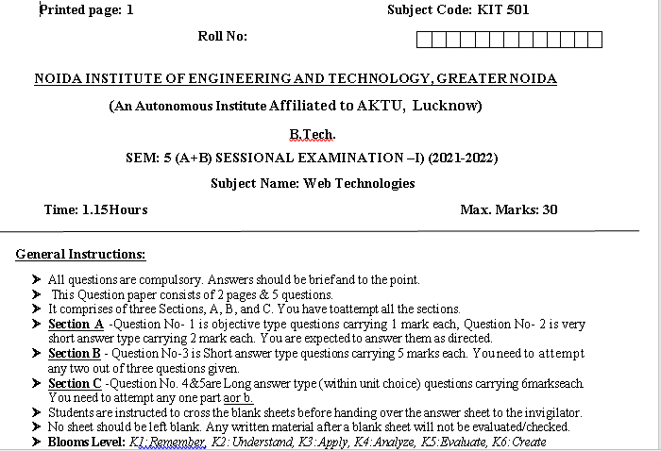
Sessional Paper

Slide 111
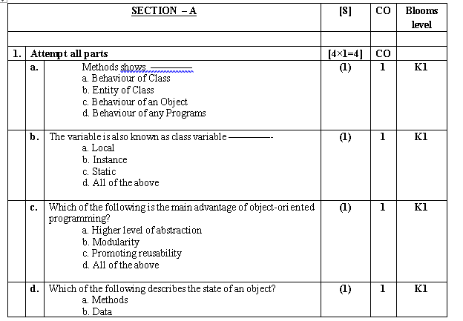
Sessional Paper

Slide 112
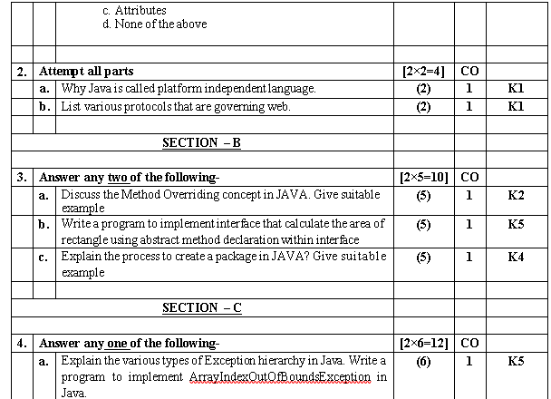
Sessional Paper

Slide 113
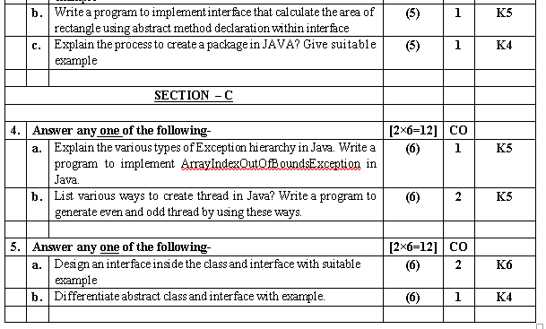
Sessional Paper

Slide 114
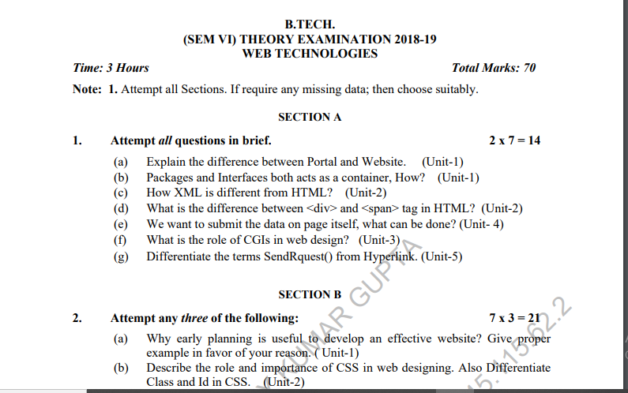
Old Question Paper

Slide 115
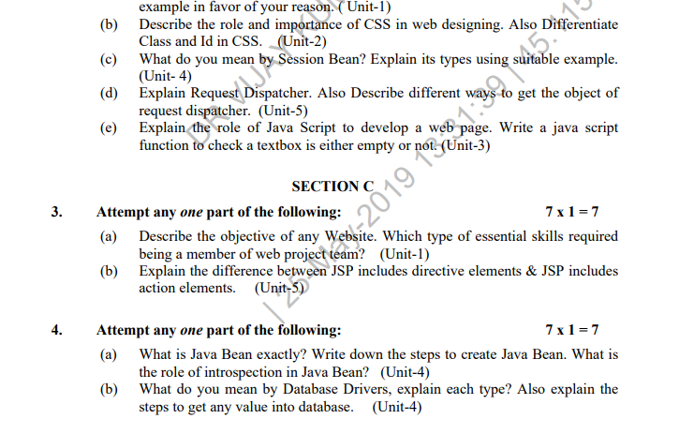
Old Question Paper(cont..)

Slide 116
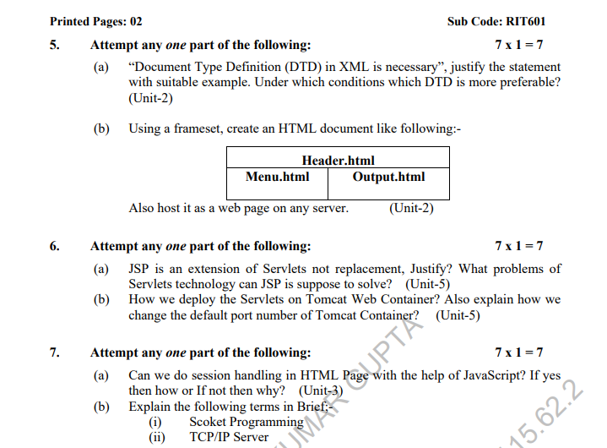
Old Question Paper(cont..)

Slide 117
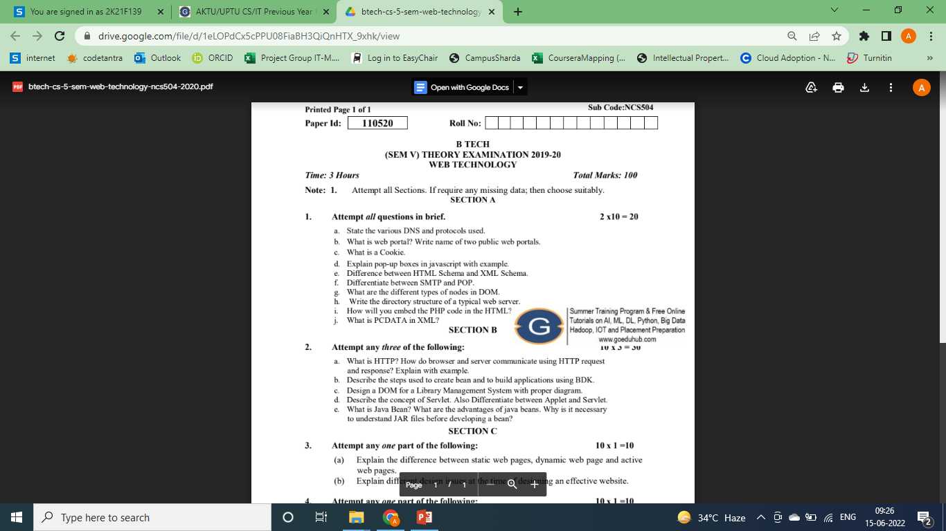
Old Question Paper(cont..)

Slide 118
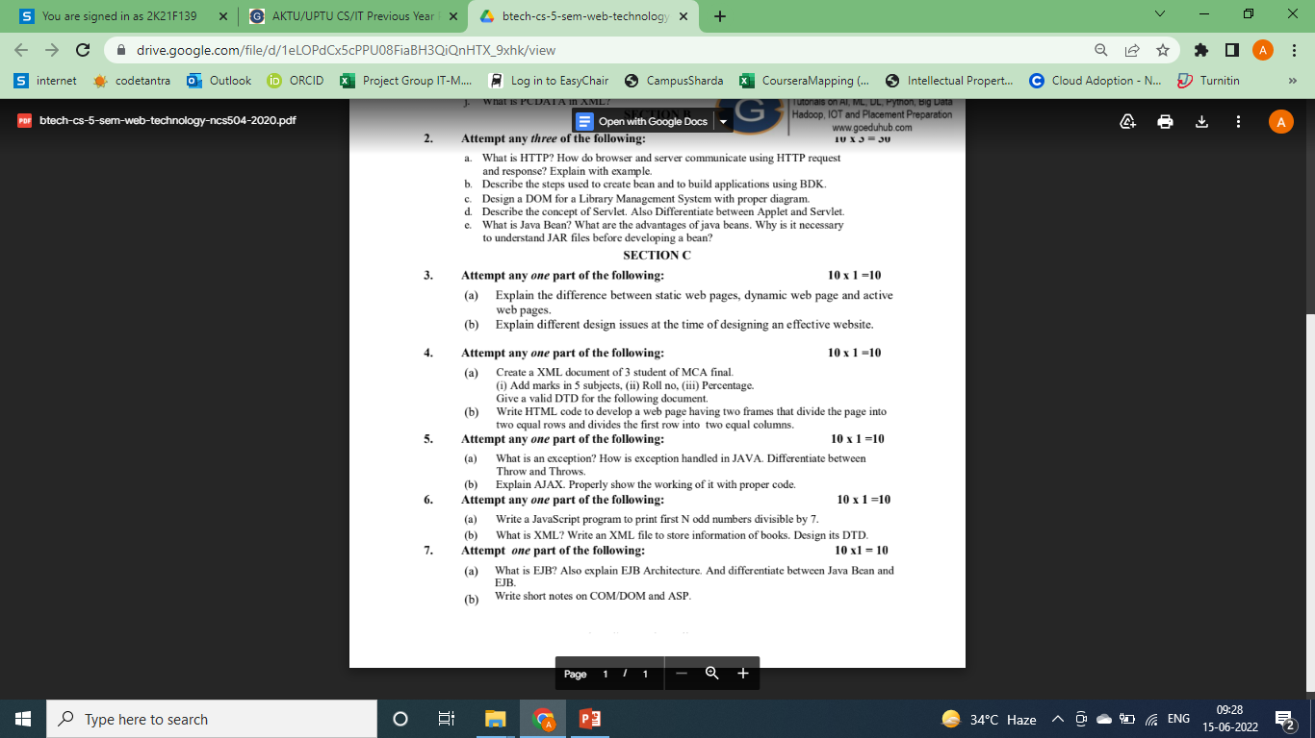
Old Question Paper(cont..)

Slide 119
Faculty Video Links, Youtube & NPTEL Video Links and Online Courses Details
https://www.youtube.com/watch?v=KMj49syT8JM&list=PLJ5C_6qdAvBHiqw9Yc7-_vyfbBG1Bmfg_
https://www.youtube.com/watch?v=biKUffL8cm4&list=PLJ5C_6qdAvBHiqw9Yc7-_vyfbBG1Bmfg_&index=2
https://www.youtube.com/watch?v=jyzBKgXxHww&list=PLJ5C_6qdAvBHiqw9Yc7-_vyfbBG1Bmfg_&index=3
https://www.youtube.com/watch?v=g6zGd6ycktY&list=PLo4R2IscWKdVqzh_QECsxCq7QB1CUpYfi&index=1
https://www.youtube.com/watch?v=g6zGd6ycktY&list=PLo4R2IscWKdVqzh_QECsxCq7QB1CUpYfi&index=2
https://www.youtube.com/watch?v=g6zGd6ycktY&list=PLo4R2IscWKdVqzh_QECsxCq7QB1CUpYfi&index=3

Slide 120
Faculty Video Links, Youtube & NPTEL Video Links and Online Courses Details
https://www.youtube.com/watch?v=g6zGd6ycktY&list=PLo4R2IscWKdVqzh_QECsxCq7QB1CUpYfi&index=4
https://www.youtube.com/watch?v=g6zGd6ycktY&list=PLo4R2IscWKdVqzh_QECsxCq7QB1CUpYfi&index=5
https://www.youtube.com/watch?v=g6zGd6ycktY&list=PLo4R2IscWKdVqzh_QECsxCq7QB1CUpYfi&index=6
https://www.youtube.com/watch?v=g6zGd6ycktY&list=PLo4R2IscWKdVqzh_QECsxCq7QB1CUpYfi&index=7
https://www.youtube.com/watch?v=g6zGd6ycktY&list=PLo4R2IscWKdVqzh_QECsxCq7QB1CUpYfi&index=8

Slide 121
Expected Questions for University Exam
Define PHP with its syntax.
Explain variables & constants with example and code.
What do you mean by data type, operator & expressions.
Define control flow and decision making statements.
What do you mean by functions, strings and arrays.
Explain file & directory, and give commands for opening, closing, coping, renaming and deleting a file.
Give commands for creating or deleting folder, file uploading & downloading.
Introduce the session control with session functionality.
What is a Cookie? Explain setting cookies with PHP.

Slide 122
TEXT BOOKS:
(1.) Web Technologies, Black Book, Dreamtech Press.
(2.) Internet and world wide web how to program, P.J. Deitel & H.M. Deitel, Pearson
[3] Xavier, C,” Web Technology and Design”, New Age International.
REFERENCES:
(1.) Ivan Bayross,”HTML, DHTML, JavaScript,Perl & CGI”, BPB Publication.
(2.) Developing Web Applications, Ralph Moseley and M.T. Savaliya, Wiley-India
(3.) Developing Web Applications in PHP and AJAX, Harwani, McGraw Hill.

Slide 123
THANKYOU

